Slide 1
Arithmetic and Modulus

Slide 2
Common algebraic operations
*
Multiply
**
Exponent
//
Integer Division, always rounds down
/
Floating point division
+
Addition
-
Subtraction

Slide 3
Modulus
% operator
10 % 2 = 0
10 % 5 = 0
10 % 3 = 1
10 % 4 = 2 WHATS HAPPENING?????

Slide 4
Modulus behavior
Modulus asks: what is the remainder of division!
Modulus is super important!
Your password only works because of modulus arithmetic
What if I asked you to reverse the number 12345 to make it 54321?
Answer on next slide

Slide 5
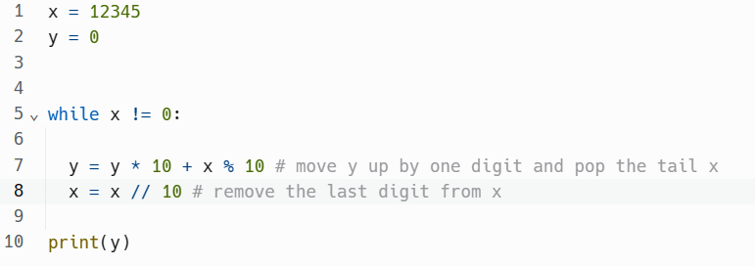
Solution

